Slide 1
City comparisons (New York, San Francisco, and Chicago)

Slide 2
INSTRUCTIONS FOR USE
The Question
City comparisons (New York, San Francisco, and Chicago)

Slide 3
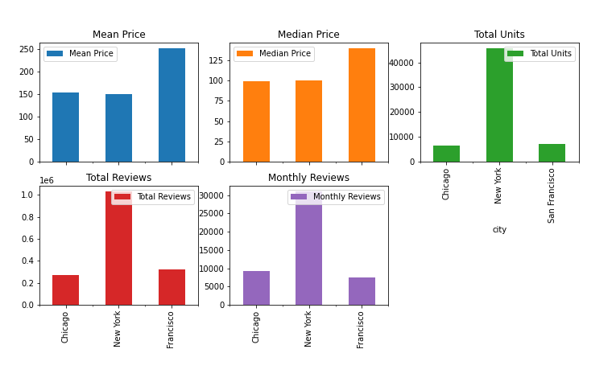
Notes:
Entire home/apt - Majority / shared room- least(LA & New York)

Slide 4
From the visualization, we can see that New York has the most units and the most reviews but San Francisco has the highest mean and median prices.

